Slide 1
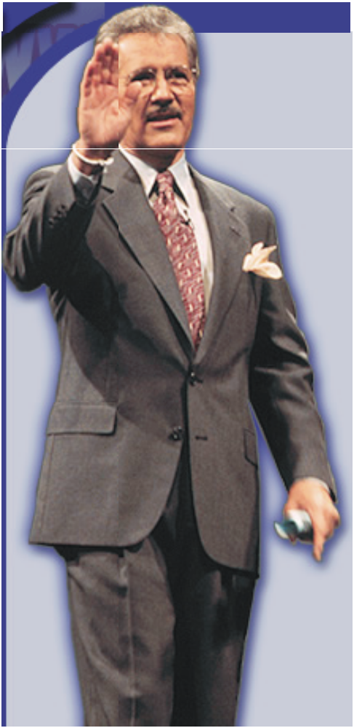




Welcome
to
Jeopardy!

Slide 2
Another
Mark E. Damon
Presentation
© 2001 - All rights Reserved
markedamon@hotmail.com

Slide 3
Directions:
Scroll through the presentation and enter the answers (which are really the questions) and the questions (which are really the answers).
Enter in the categories on the main game boards.
As you play the game, click on the TEXT DOLLAR AMOUNT that the contestant calls, not the surrounding box.
When they have given a question, click again anywhere on the screen to see the correct question. Keep track of which questions have already been picked by printing out the game board screen and checking off as you go.
Click on the “Game” box to return to the main scoreboard.
Enter the score into the black box on each players podium.
Continue until all clues are given.
When finished, DO NOT save the game. This will overwrite the program with the scores and data you enter. You MAY save it as a different name, but keep this file untouched!

Slide 4




Round 1
Final
Jeopardy
Olivia
Daphne
Kendall
Sandra

Slide 5
JEOPARDY: Molecular Biology and Genomics Edition
HNPCC and MMR
PCR and
DNA Replication
Yeast transformation
FOA complementation assay
SDS-PAGE and western blotting
Restriction enzymes
Round 1
$100
$100
$100
$100
$100
$100
Final Jeopardy
$200
$200
$200
$200
$200
$200
Scores
$300
$300
$300
$300
$300
$300
$400
$400
$400
$400
$400
$400
$500
$500
$500
$500
$500
$500

Slide 6
$100
FAP and HNPCC

Slide 7
$100
What are most common two forms of inherited colorectal cancer?
Scores

Slide 8
$200
Key element of Mismatch Repair System

Slide 9
$200
What is MSH2 gene?
Scores

Slide 10
$300
Short repetitive sequences of DNA.

Slide 11
$300
What is microsatelite DNA?
Scores

Slide 12
$400
Mut S, Mut H and Mut L

Slide 13
$400
What are the components of MMR in prokaryotes?
Scores

Slide 14
$500
Direct Repair
Base Excision repair
Nucleotide excision repair
Double-strand break repair
Mismatch repair

Slide 15
$500
What are the different types of DNA damage repair systems?
Scores

Slide 16
$100
Enzyme responsible for synthesizing an oligonucleotide that starts the replication process

Slide 17
$100
What is primase?
Scores

Slide 18
$200
Stage of the cell cycle during which mismatch repair is occurs

Slide 19
$200
What is S-phase?
Scores

Slide 20
$300
Special type of an enzyme used in PCR which is resistant to changes in temperature

Slide 21
$300
What is Taq polymerase?
Scores

Slide 22
Daily
Double

Slide 23
$400
It replaces the need for helicase, SSBPs, and topoisomerase during PCR

Slide 24
$400
What is increasing temperature to 95°C?
Scores

Slide 25
$500
Taq Plymerase, reaction Buffer, MgCl2, BSA, and dNTPs

Slide 26
$500
What are the components of the Ready-To-Go PCR beads?
Scores

Slide 27
$100
Specific sequence in DNA recognized by an enzyme

Slide 28
$100
What is a restriction site?
Scores

Slide 29
$200
5’ G GATCC
3’ CCTAG G

Slide 30
$200
What is a sticky end?
Scores

Slide 31
$300
Helps us separate DNA fragments after enzyme digestion

Slide 32
$300
What is agarose gel electrophoresis?
Scores

Slide 33
$400
Chemical molecule which allows for visualization of the DNA bands on an agarose gel

Slide 34
$400
What is ethidium bromide?
Scores

Slide 35
$500
Cleavage of the infecting DNA to prevent it from successfully replicating and parasitizing the cell

Slide 36
$500
What is the biological role of restriction enzymes?
Scores

Slide 37
$100
HIS+

Slide 38
$100
What is a dominant trait with no requirement for histidine?
Scores

Slide 39
$200
Unicellular, eukaryotic organism which may function as haploid and diploid form

Slide 40
$200
What are yeast?
Scores

Slide 41
$300
Introduction of an exogenous DNA with inheritance and expression of the trait

Slide 42
$300
What is transformation?
Scores

Slide 43
$400
A gene that when introduced to yeast, it restores the yeast’s ability to perform a specific function

Slide 44
$400
What is a positive selection marker?
Scores

Slide 45
$500
msh2∆
trp1-1
his3-11,15
ura3-1

Slide 46
$500
What are the characteristics of our yeast strain?
Scores

Slide 47
$100
Needs to be added to the plate in order to determine if the MSH2 is working

Slide 48
$100
What is FOA?
Scores

Slide 49
$200
Metabolizes 5-FOA to 5-FU

Slide 50
$200
What is URA3?
Scores

Slide 51
$300
Yeast colonies grow on the FOA plate

Slide 52
$300
What is a dysfunctional MMR/MSH2?
Scores

Slide 53
$400
When yeast colonies grow on this plate it means transformation was successful

Slide 54
$400
What is the SD-his-trp plate?
Scores

Slide 55
$500
This strategically placed DNA sequence allows us to determine whether MSH2 is functional

Slide 56
$500
What is microsatellite DNA upstream of URA3?
Scores

Slide 57
$100
This chemical allows us to linearize extracted proteins and gives them a negative charge

Slide 58
$100
What is SDS?
Scores

Slide 59
$200
Molecule which recognizes a specific antigen

Slide 60
$200
What is an antibody?
Scores

Slide 61
$300
This technique allows us to separate protein based on their size not their charge

Slide 62
$300
What is SDS-PAGE?
Scores

Slide 63
$400
Process of relocating the proteins from the gel onto a nitrocellulose membrane

Slide 64
$400
What is gel transfer ?
Scores

Slide 65
$500
Allows us to visualize the bands of protein on a nitrocellulose membrane

Slide 66
$500
What is enhanced chemi- luminescence?
Scores

Slide 67

Final
Jeopardy
Final Jeopary Question
Scores

Slide 68
Diploid tumor with microsatellite instability and lacks polyps in distal colon.

Slide 69
What are the characteristics of HNPCC?
Scores

Slide 71
Subject
1
Subject
2
Subject
3
Subject
4
Subject
5
Subject
6
Round 1
$200
$200
$200
$200
$200
$200
Final Jeopardy
$400
$400
$400
$400
$400
$400
Scores
$600
$600
$600
$600
$600
$600
$800
$800
$800
$800
$800
$800
$1000
$1000
$1000
$1000
$1000
$1000

Slide 72
$200
Enter Answer Here for
Category 1 - Question 1

Slide 73
$200
Enter Question Here for
Category 1 - Question 1
Scores

Slide 74
$400
Enter Answer Here for
Category 1 - Question 2

Slide 75
$400
Enter Question Here for
Category 1 - Question 2
Scores

Slide 76
$600
Enter Answer Here for
Category 1 - Question 3

Slide 77
$600
Enter Question Here for
Category 1 - Question 3
Scores

Slide 78
$800
Enter Answer Here for
Category 1 - Question 4

Slide 79
$800
Enter Question Here for
Category 1 - Question 4
Scores

Slide 80
$1000
Enter Answer Here for
Category 1 - Question 5

Slide 81
$1000
Enter Question Here for
Category 1 - Question 5
Scores

Slide 82
$200
Enter Answer Here for
Category 2 - Question 1

Slide 83
$200
Enter Question Here for
Category 2 - Question 1
Scores

Slide 84
Daily
Double

Slide 85
$400
Enter Answer Here for
Category 2 - Question 2

Slide 86
$400
Enter Question Here for
Category 2 - Question 2
Scores

Slide 87
$600
Enter Answer Here for
Category 2 - Question 3

Slide 88
$600
Enter Question Here for
Category 2 - Question 3
Scores

Slide 89
$800
Enter Answer Here for
Category 2 - Question 4

Slide 90
$800
Enter Question Here for
Category 2 - Question 4
Scores

Slide 91
$1000
Enter Answer Here for
Category 2 - Question 5

Slide 92
$1000
Enter Question Here for
Category 2 - Question 5
Scores

Slide 93
$200
Enter Answer Here for
Category 3 - Question 1

Slide 94
$200
Enter Question Here for
Category 3 - Question 1
Scores

Slide 95
$400
Enter Answer Here for
Category 3 - Question 2

Slide 96
$400
Enter Question Here for
Category 3 - Question 2
Scores

Slide 97
$600
Enter Answer Here for
Category 3 - Question 3

Slide 98
$600
Enter Question Here for
Category 3 - Question 3
Scores

Slide 99
$800
Enter Answer Here for
Category 3 - Question 4

Slide 100
$800
Enter Question Here for
Category 3 - Question 4
Scores

Slide 101
$1000
Enter Answer Here for
Category 3 - Question 5

Slide 102
$1000
Enter Question Here for
Category 3 - Question 5
Scores

Slide 103
$200
Enter Answer Here for
Category 4 - Question 1

Slide 104
$200
Enter Question Here for
Category 4 - Question 1
Scores

Slide 105
$400
Enter Answer Here for
Category 4 - Question 2

Slide 106
$400
Enter Question Here for
Category 4 - Question 2
Scores

Slide 107
Daily
Double

Slide 108
$600
Enter Answer Here for
Category 4 - Question 3

Slide 109
$600
Enter Question Here for
Category 4 - Question 3
Scores

Slide 110
$800
Enter Answer Here for
Category 4 - Question 4

Slide 111
$800
Enter Question Here for
Category 4 - Question 4
Scores

Slide 112
$1000
Enter Answer Here for
Category 4 - Question 5

Slide 113
$1000
Enter Question Here for
Category 4 - Question 5
Scores

Slide 114
$200
Enter Answer Here for
Category 5 - Question 1

Slide 115
$200
Enter Question Here for
Category 5 - Question 1
Scores

Slide 116
$400
Enter Answer Here for
Category 5 - Question 2

Slide 117
$400
Enter Question Here for
Category 5 - Question 2
Scores

Slide 118
$600
Enter Answer Here for
Category 5 - Question 3

Slide 119
$600
Enter Question Here for
Category 5 - Question 3
Scores

Slide 120
$800
Enter Answer Here for
Category 5 - Question 4

Slide 121
$800
Enter Question Here for
Category 5 - Question 4
Scores

Slide 122
$1000
Enter Answer Here for
Category 5 - Question 5

Slide 123
$1000
Enter Question Here for
Category 5 - Question 5
Scores

Slide 124
$200
Enter Answer Here for
Category 6 - Question 1

Slide 125
$200
Enter Question Here for
Category 6 - Question 1
Scores

Slide 126
$400
Enter Answer Here for
Category 6 - Question 2

Slide 127
$400
Enter Question Here for
Category 6 - Question 2
Scores

Slide 128
$600
Enter Answer Here for
Category 6 - Question 3

Slide 129
$600
Enter Question Here for
Category 6 - Question 3
Scores

Slide 130
$800
Enter Answer Here for
Category 6 - Question 4

Slide 131
$800
Enter Question Here for
Category 6 - Question 4
Scores

Slide 132
$1000
Enter Answer Here for
Category 6 - Question 5

Slide 133
$1000
Enter Question Here for
Category 6 - Question 5
Scores

